Slide 1
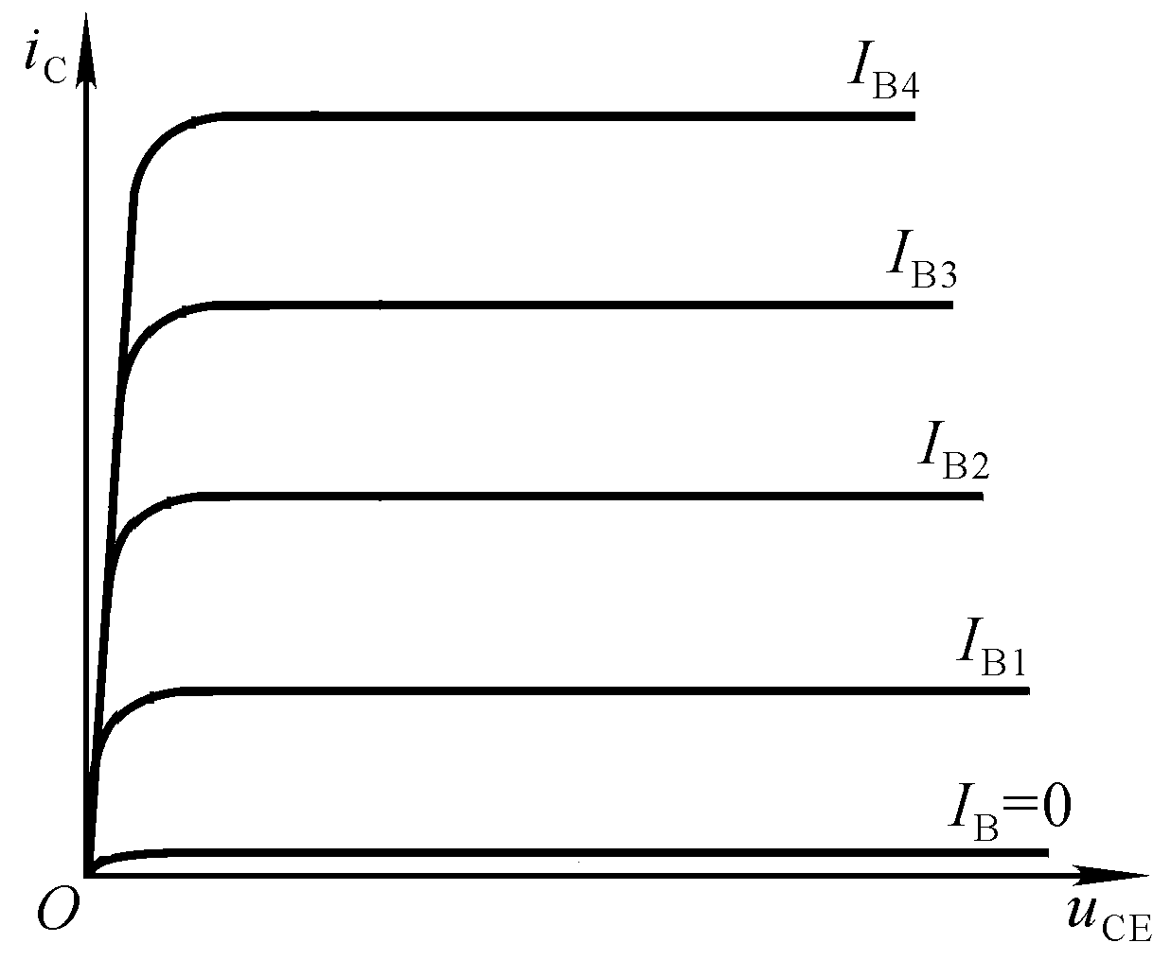
Saturation region: i_{c} is mainly controlled
by v_{ce}, βi_{b} > i_{c}
Saturation
Active region: i_{c} is basically parallel with
v_{ce}, βi_{b} = i_{c}
Active
Cutoff region: i_{c} is approaching to 0,
i_{b} i_{c} 0
Cutoff
Notes:
Most of electrons will go from E to B, just a miniority of electrons will go through B to arrive C.

Slide 2
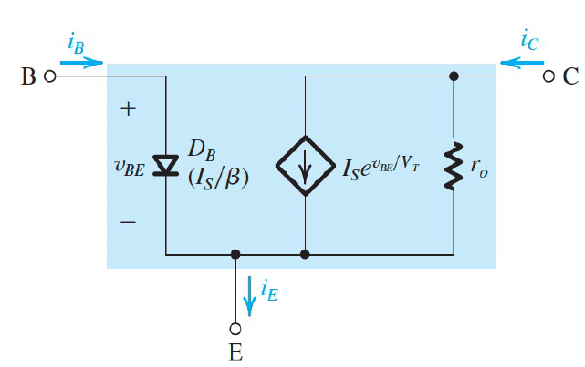
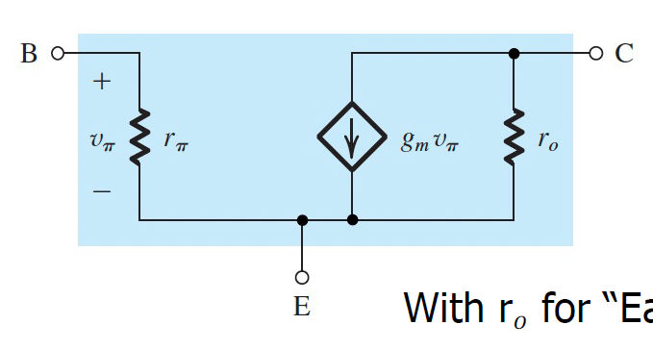
Early effect:
Notes:
A example should be given here.

Slide 3
For DC signal:
Simplified
Alternatives
Q point:
Only one DC power is involved

Slide 4
Bipolar Junction Transistors
Peng Mei
Department of Electronic Systems
Email: mei@es.aau.dk

Slide 5
Learning objectives:
Transistor-based amplifier
Lab session

Slide 6
Using a diagram to analyze a BJT amplification circuit:
First step: draw the DC circuit
Input i – v curve:
v_{BE} =V_{CC}－i_{B}R_{b}
Output i – v curve:
v_{CE}=V_{CC}－i_{C}R_{c}

Slide 7
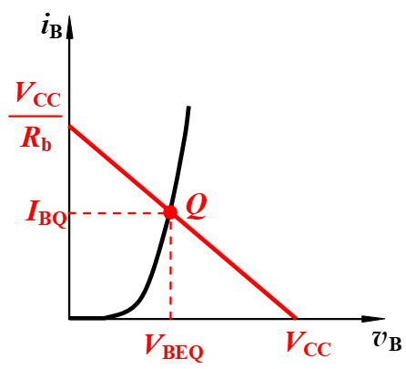
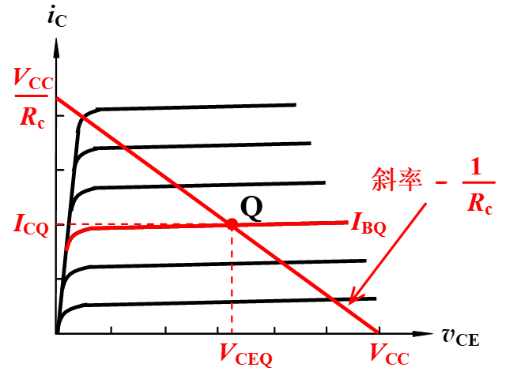
Diagram analysis of static operating point :
v_{BE} =V_{CC}－i_{B}R_{b}
v_{CE}=V_{CC}－i_{C}R_{c}

Slide 8
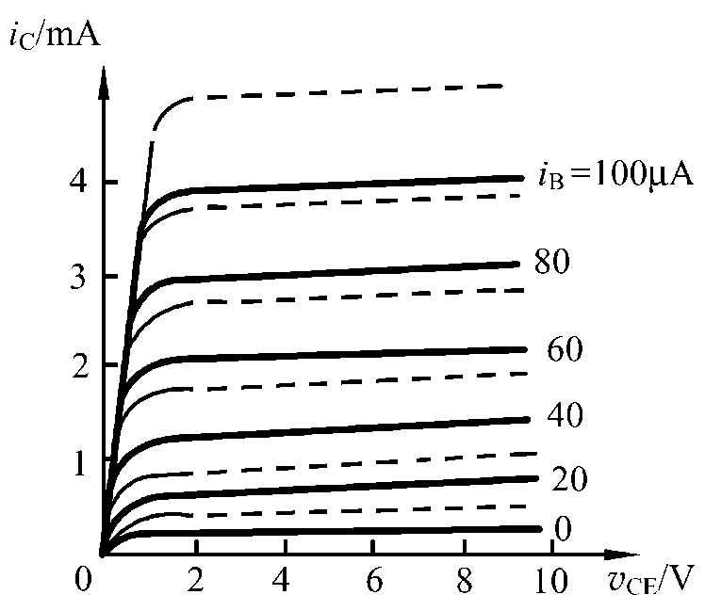
Effects of temperature on Q point :
Temperature rising
Temperature
rising
Q₁
Q

Slide 9
The effects of Q point on waveform distortion:

Slide 10
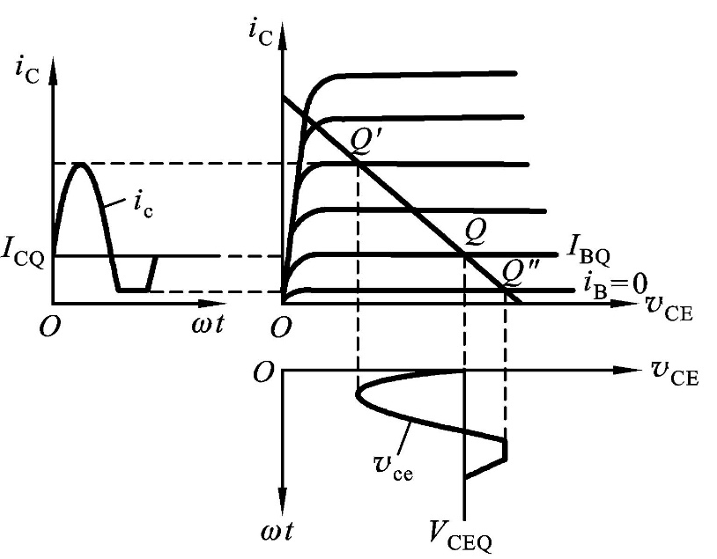
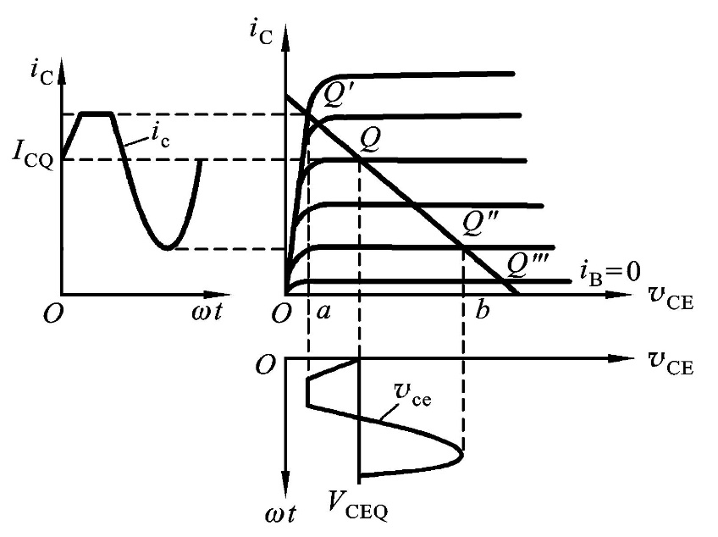
The effects of Q point on waveform distortion:
Cutoff distortion
Saturation distortion

Slide 11
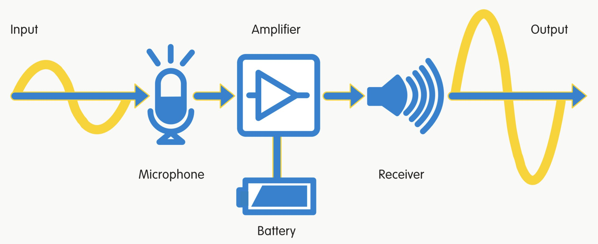
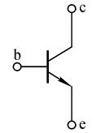

Slide 12
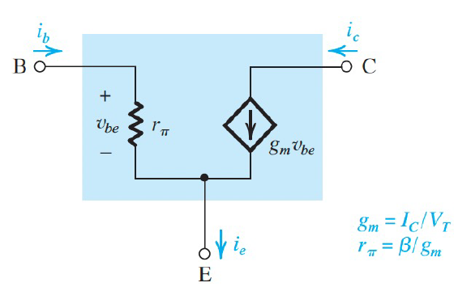
For the AC signal diagram:
Small-signal model of a BJT

Slide 13
AC small-signal amplification coefficient:

Slide 14
Input and output impedances:
i_{i}
Input impedance:
Output impedance:
R_{L} is replaced with a voltage source (v_{t}):
Input source is short:

Slide 15
For a more complicated circuit:
i_{i}
Input impedance:
Output impedance:

Slide 16
Please draw the corresponding small-signal equivalent circuit:

Slide 17
Please draw the corresponding small-signal equivalent circuit:

Slide 18
a. Calculate Q point ?
b. Calculate AC small-signal amplification
coefficient ?
Draw the small-signal equivalent circuit
β = 50

Slide 19
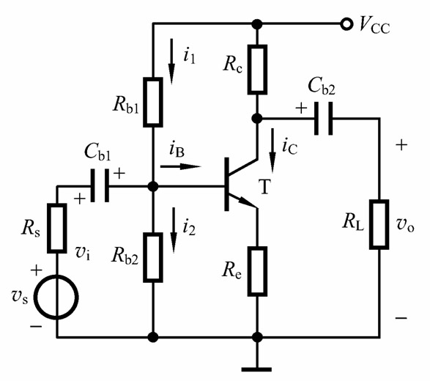
For a more complicated BJT circuit:
DC circuit
Q point:

Slide 20
For a more complicated BJT circuit:
AC circuit

Slide 21
Formulate the voltage amplification coefficient:
Interesting results found here!

Slide 22
Lab session:
V_{CC}= 15 V, R_{b1} = 309 kΩ, R_{b2} = 110 kΩ,
Re = 3.01 kΩ, Rc = 6.98 kΩ, C_{b1} = 1 uF,
C_{b2} = 1 uF, R_{L} = 10 kΩ.

Slide 23
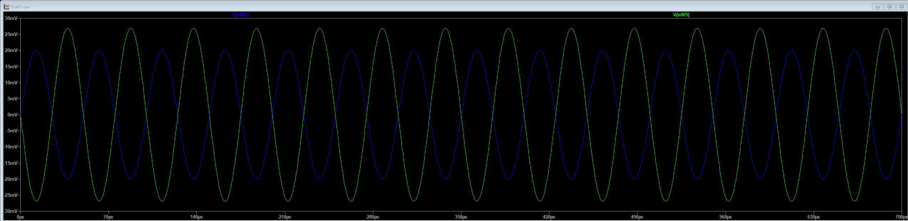
If v_{s} = 20sin(2πf) mv, f = 20 kHz, please measure v_{i} and v_{o}, and calculate the amplitude amplification coefficient A_{v.}

Slide 24
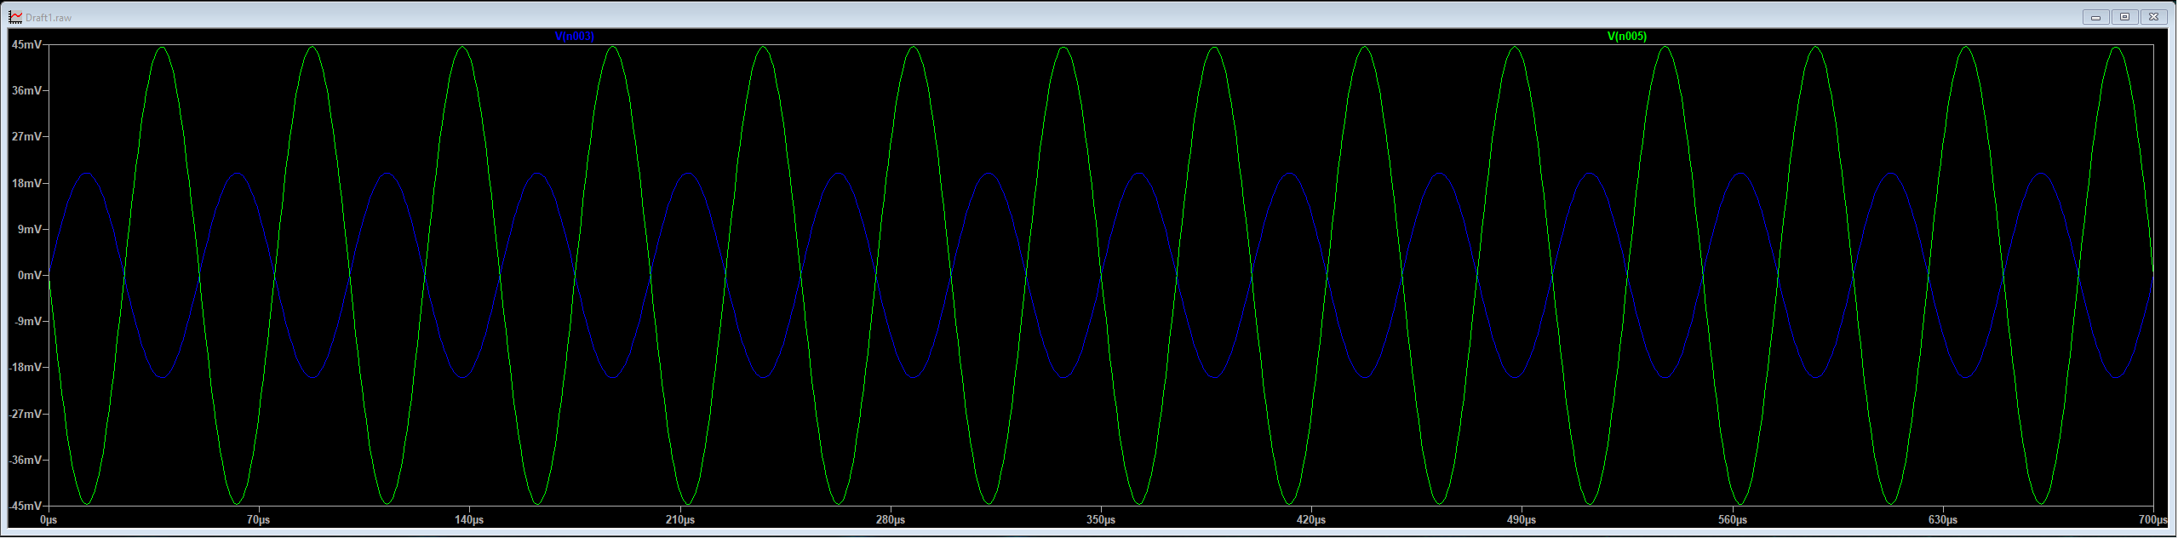
If R_{L} = 300 kΩ, please please measure v_{i} and v_{o}, and calculate the amplitude amplification coefficient A_{v.}

Slide 25
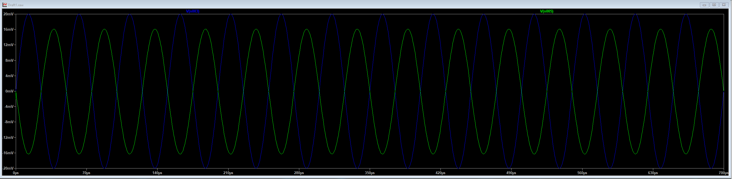
If Re = 5 kΩ, please measure v_{i} and v_{o}, and calculate the amplitude amplification coefficient A_{v.}

Slide 26
Thanks

